Slide 1

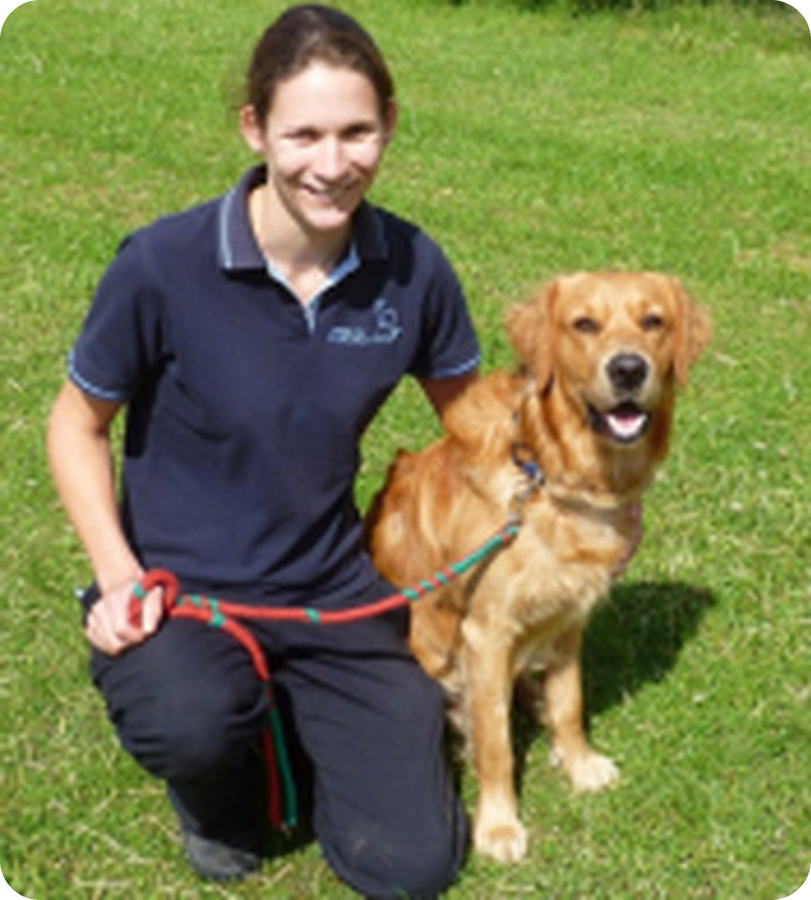
Pawsitive Pet Academy Website
Work Integrated Learning
Student name: [Rio Moraswi]
Student number: [ST10514613]
Group 2
Caring for Pets • Training for Life
Notes:
Introduce the project: the Pawsitive Pet Academy website, built for Work Integrated Learning by Group 2. Add your name and student number on this slide.

Slide 2




Project Introduction
The academy
Pawsitive Pet Academy offers friendly, reward-based dog training and pet care courses.
Purpose of the website
One clear online home where visitors learn about the academy, compare courses and get in touch.
Who it is for
Dog owners, new puppy parents and people who want a career in pet care.
Notes:
Explain who Pawsitive Pet Academy is, why the website exists and the three audiences it serves.

Slide 3






Website Objectives
Inform
Provide information about the academy
Showcase
Display the available dog training courses
Explore
Let visitors explore each course in detail
Calculate
Help customers calculate their training fees
Connect
Make contacting the academy easier
Notes:
Walk through the five objectives. Each one is delivered by a specific page, which the next slides show.

Slide 4

Home Page
Brand first: logo, tagline and a warm welcome
Trainer photo: a friendly, trustworthy introduction
Our Training: list linking to all seven courses
Clear actions: Learn More, View Courses and Contact Us buttons
Navigation bar: every page is one click away
index.html – Home
Notes:
Show the home page. Point out the logo, the trainer photo, the course list and the three action buttons.

Slide 5
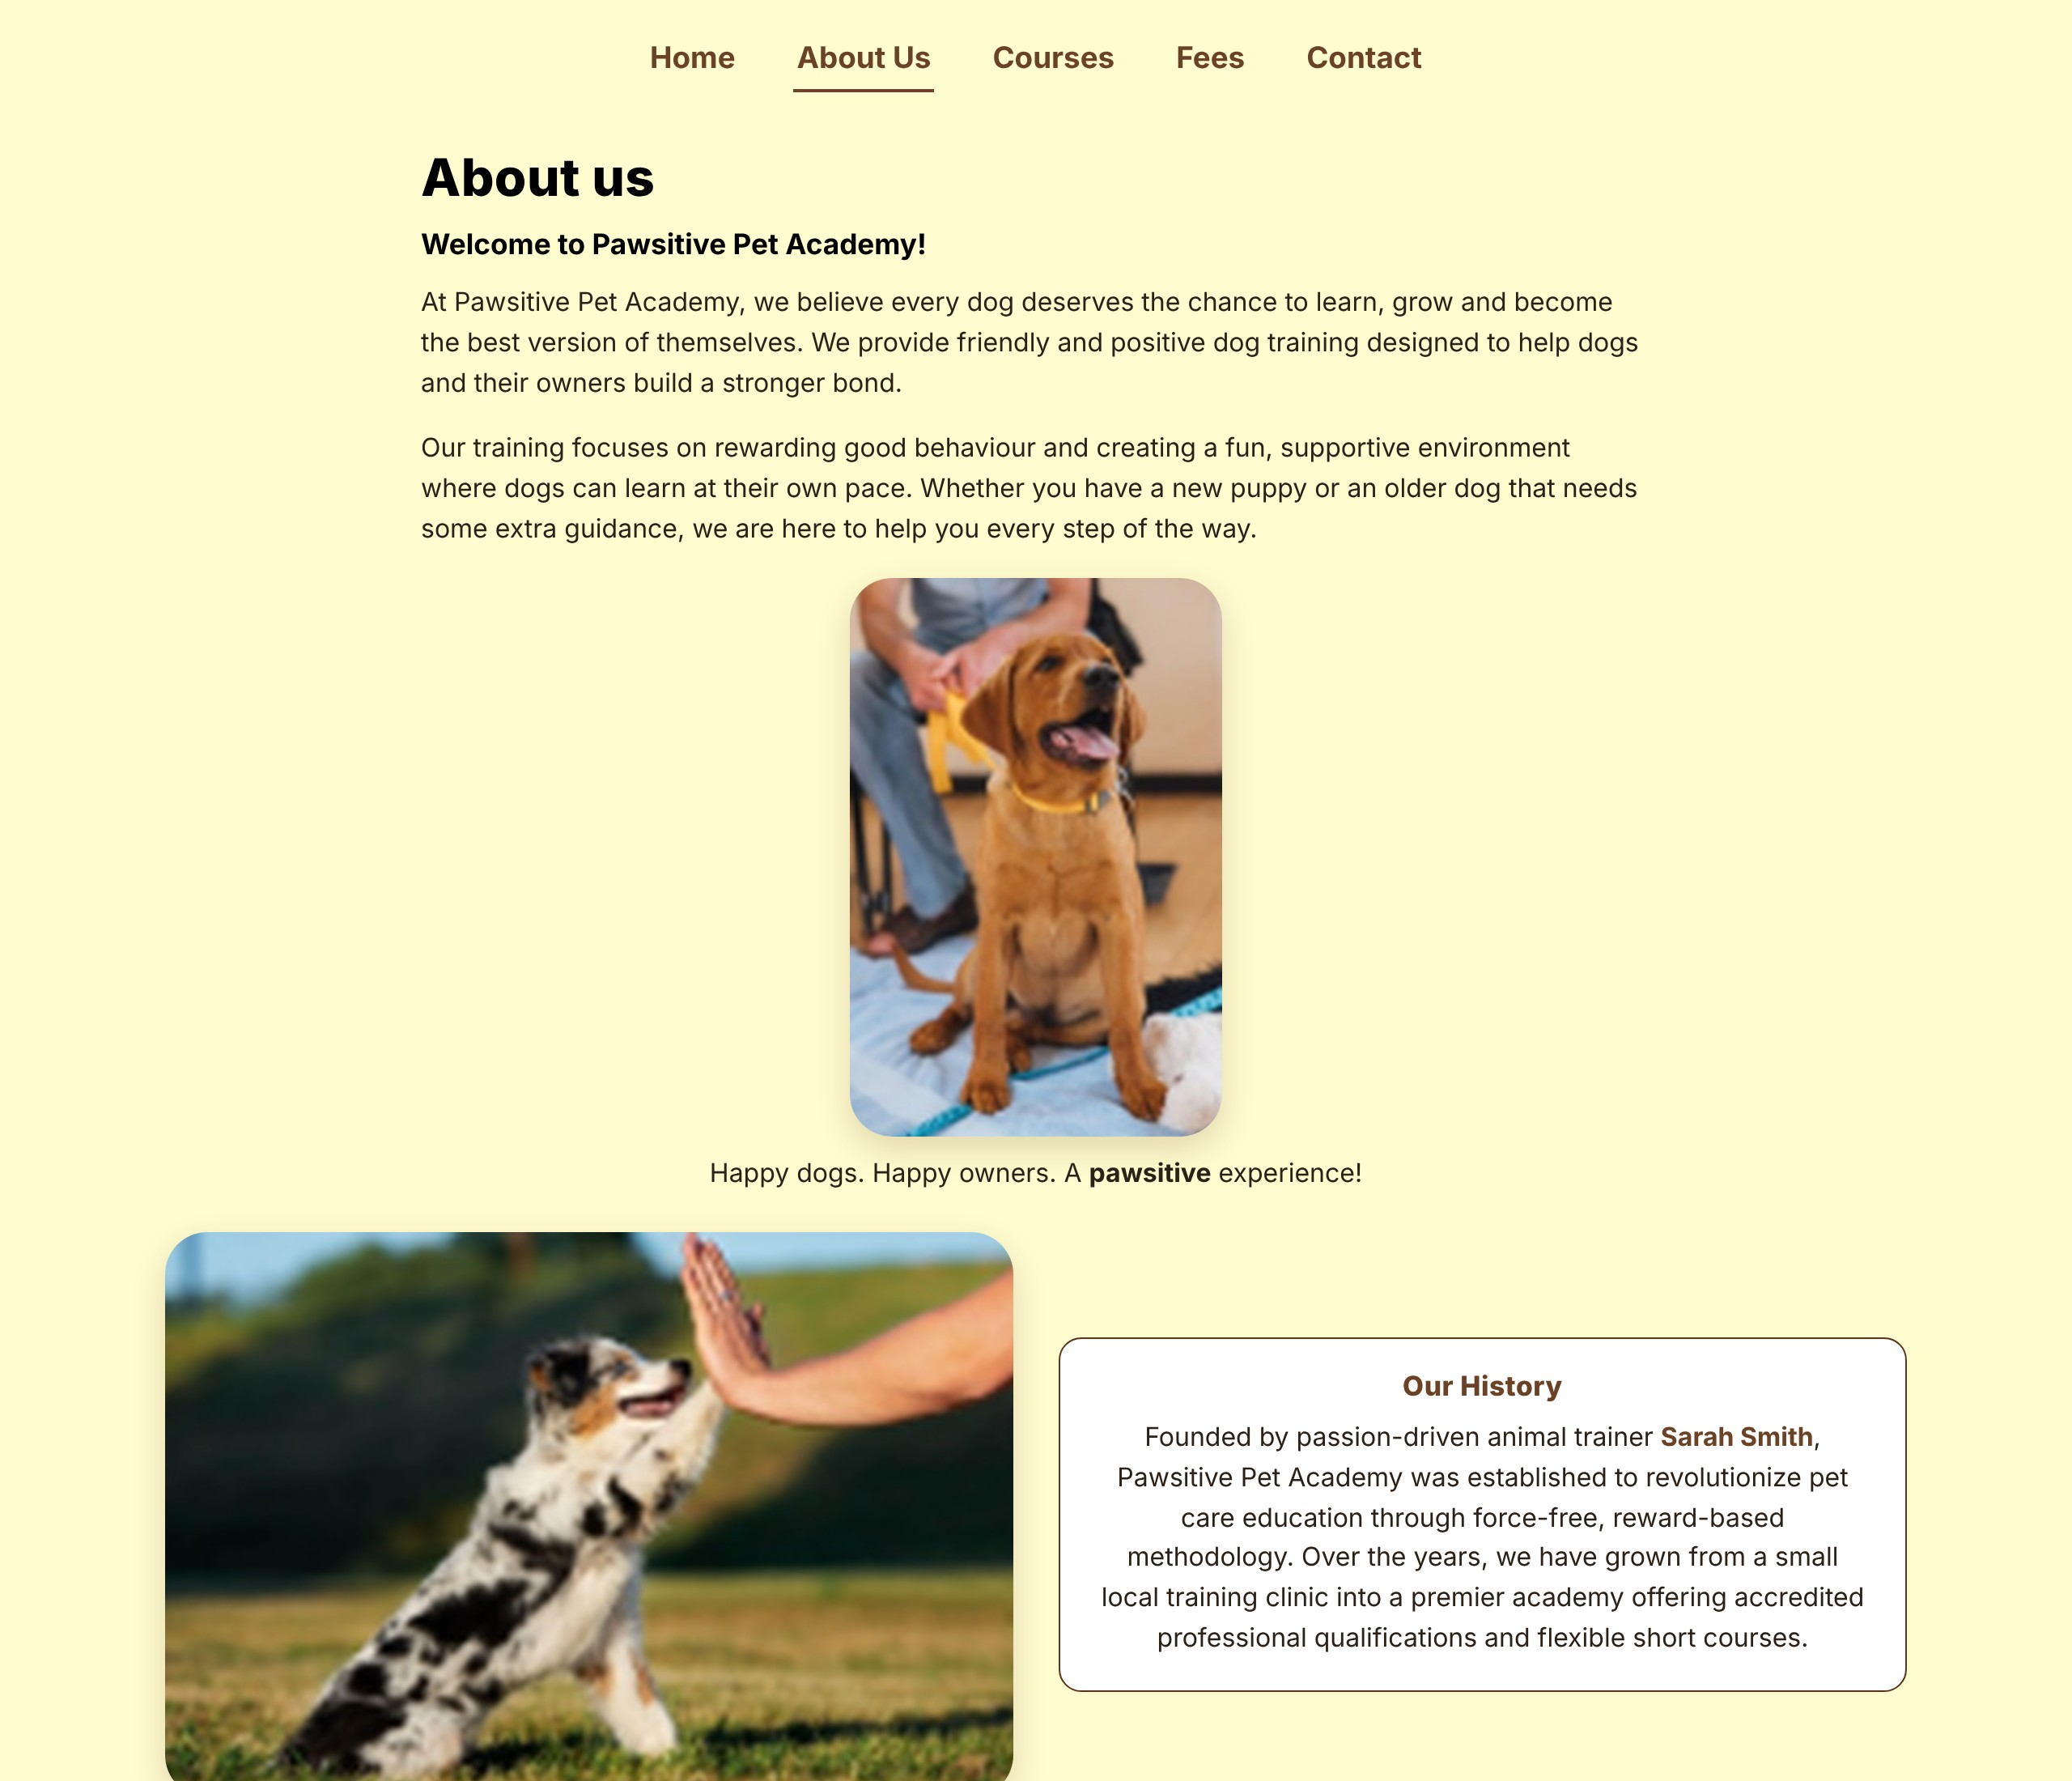
About Us Page
about.html – About Us
Welcome message: explains the friendly, positive training approach
Our History: founded by animal trainer Sarah Smith
Vision and mission: what the academy aims to achieve
Values: positive training, animal welfare and education
Photos: happy dogs and owners in training
Notes:
The About page builds trust: the academy philosophy, its history under Sarah Smith, and its vision, mission and values.

Slide 6

Course Overview
Seven course cards in a tidy, responsive grid
Each card shows the name, duration, short summary and price
View Details opens that course’s own page
Calculate Total Fees shortcut at the bottom of the page
courses.html – Our Courses
4
3
six-month courses
R1,500 each
six-week short courses
R750 each
Notes:
Visitors can browse all seven courses at a glance: four six-month programmes at R1,500 and three six-week short courses at R750.

Slide 7
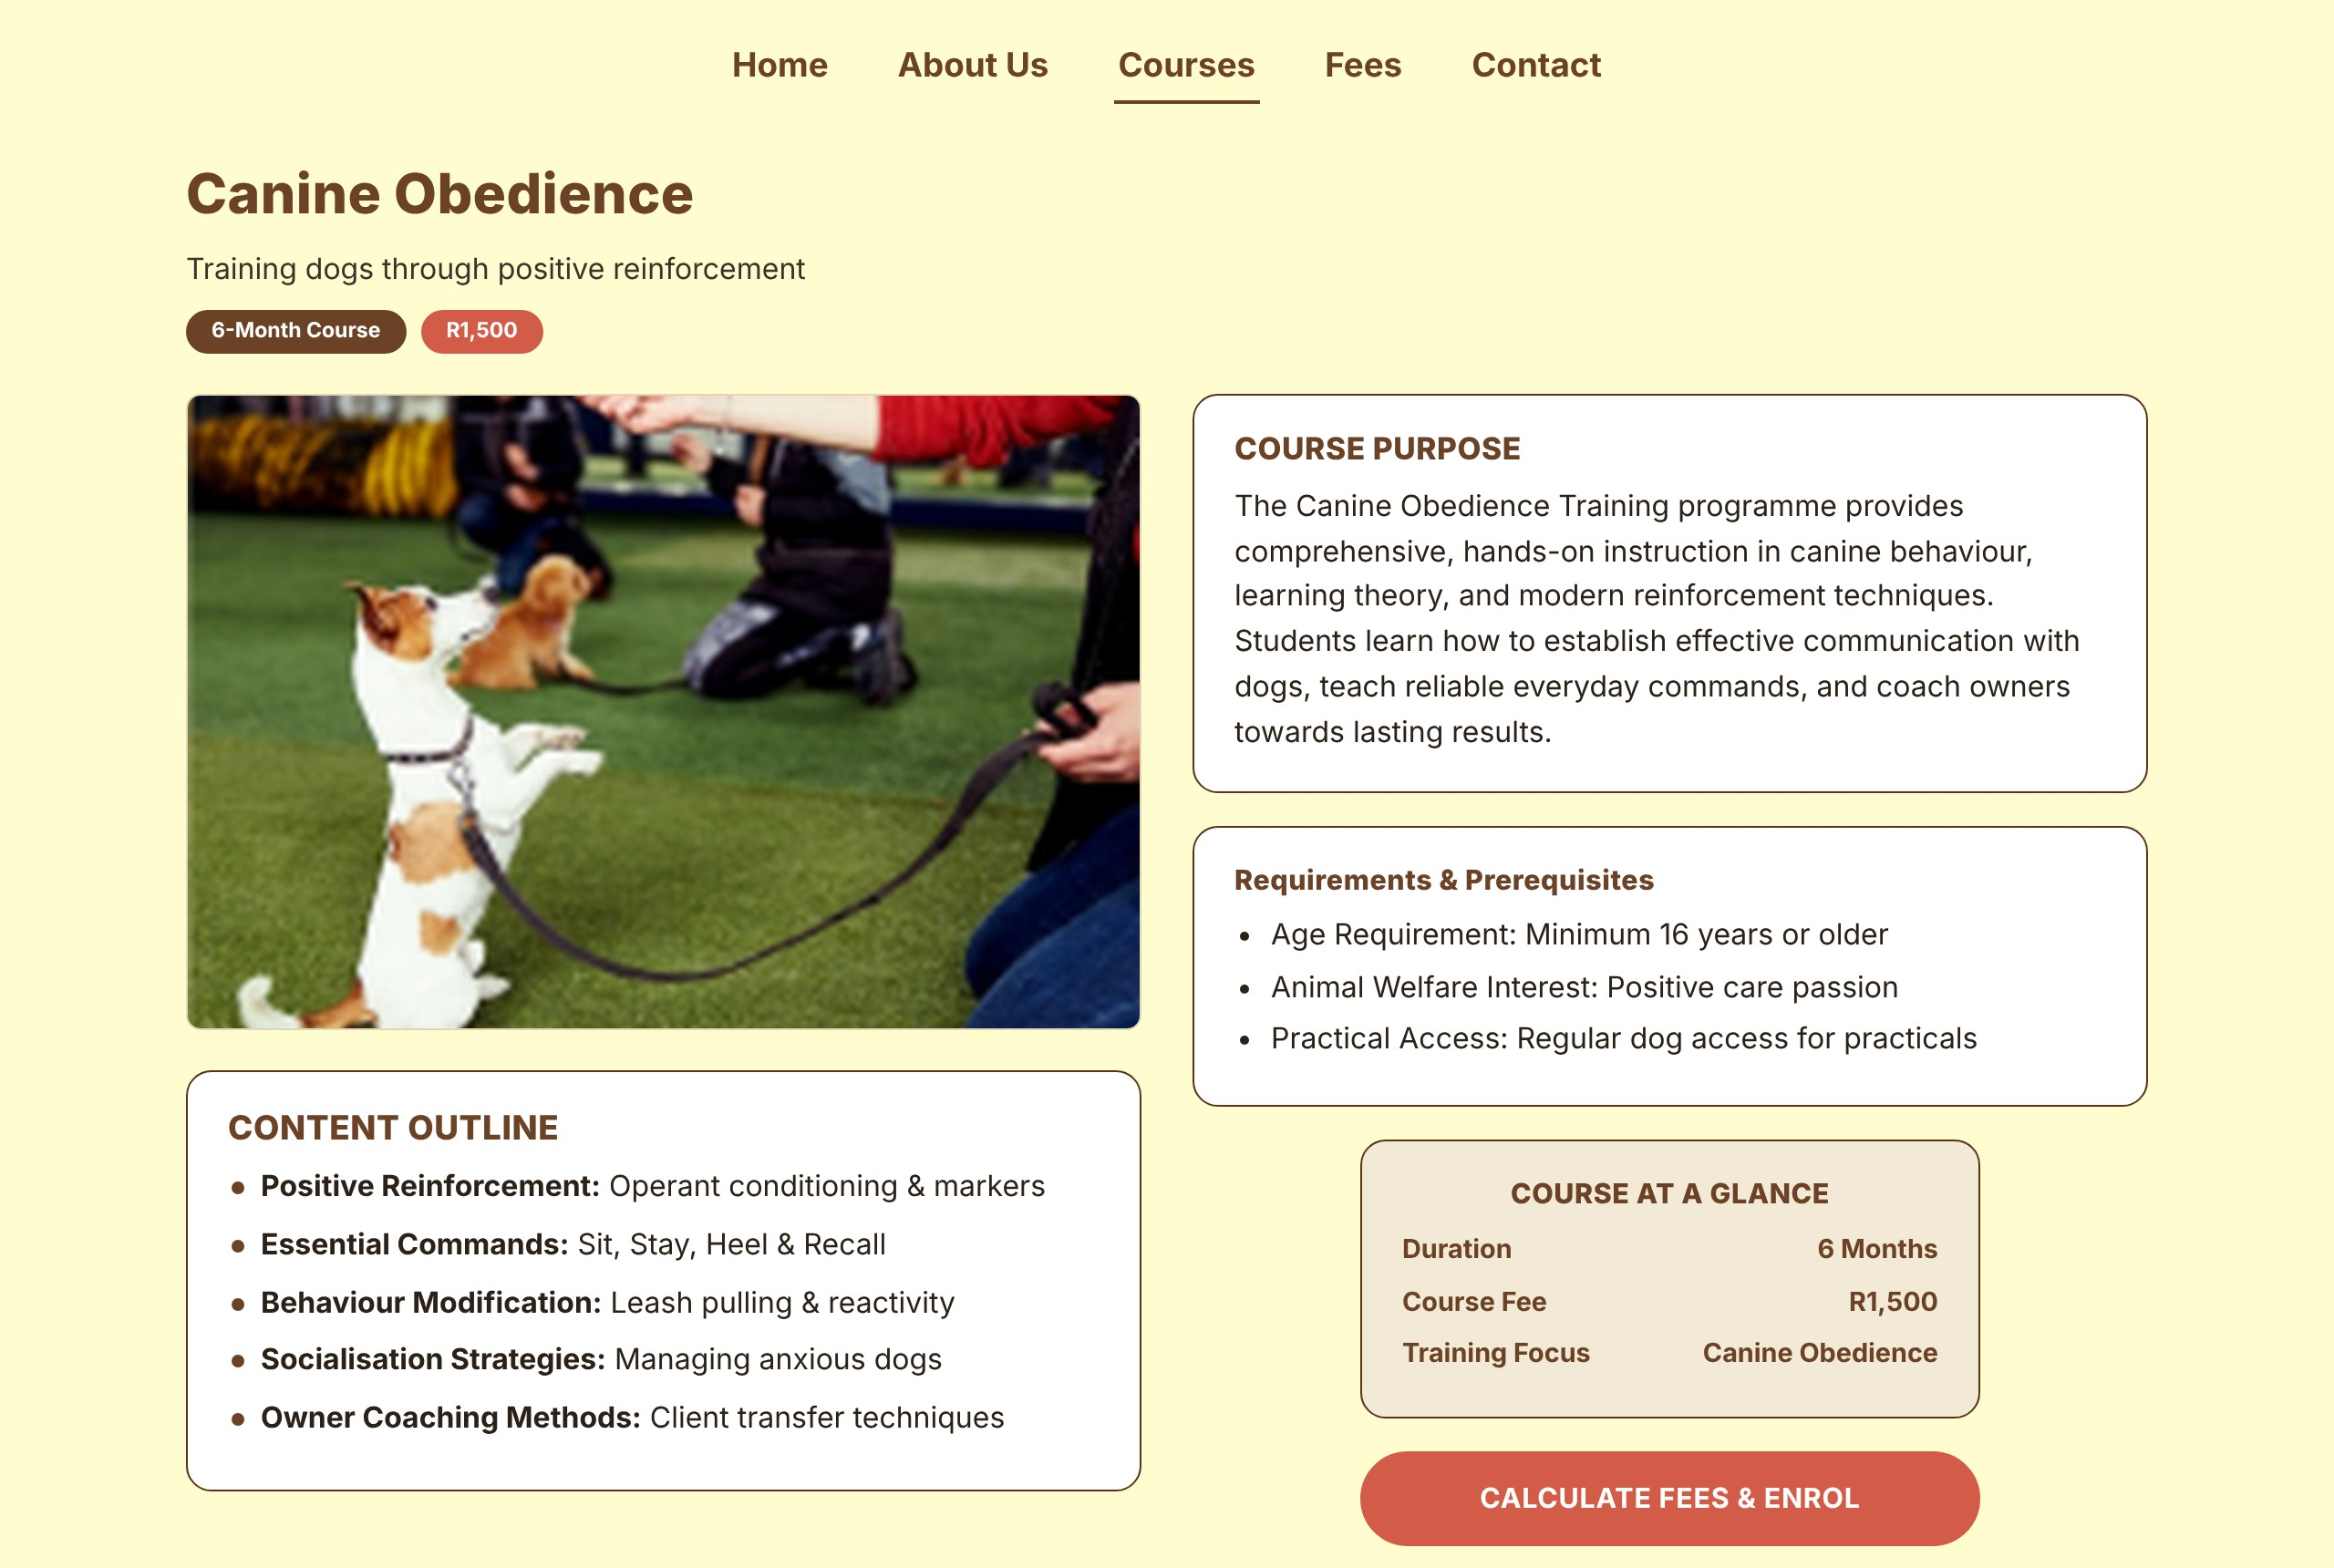
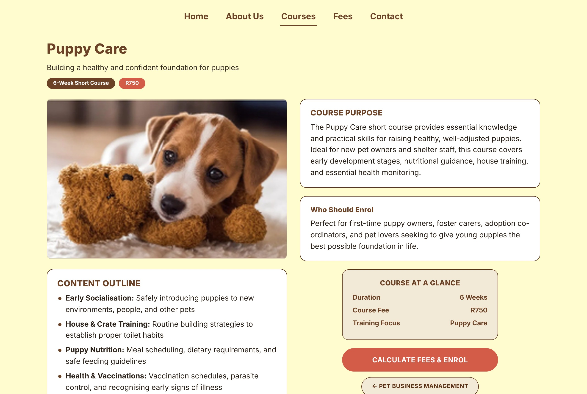

Individual Course Pages
canine-obedience.html
puppy-care.html
pet-first-aid.html
Canine Obedience
Shows requirements and prerequisites
Puppy Care
Shows who should enrol
Pet First Aid
Shows career opportunities
Every one of the seven course pages includes:
Course purpose
Content outline
Career or enrolment info
Course at a glance
Enrol and next-course links
Notes:
All seven courses use the same template, so visitors always know where to find the purpose, outline, fee and duration.

Slide 8
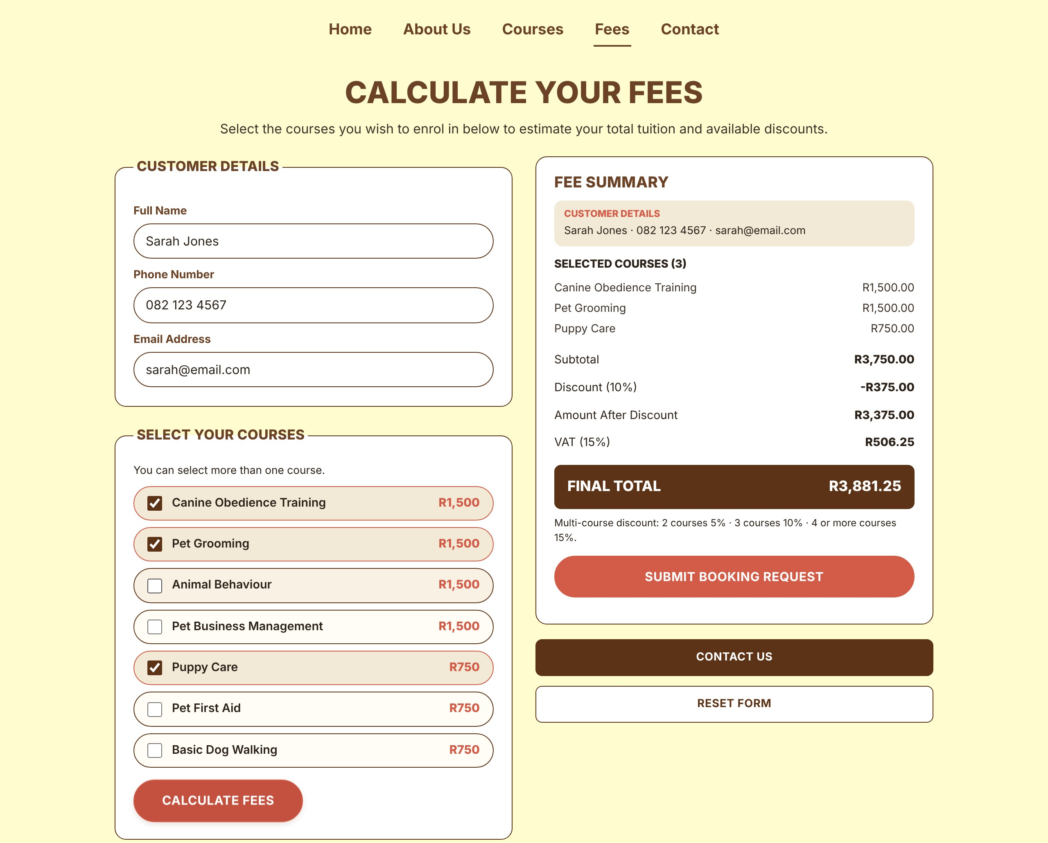
Fee Calculator
1
Enter your name, phone and email
fees.html – Calculate Your Fees
2
Tick one or more courses
3
Click Calculate Fees
4
Review the summary and submit
Worked example: 3 courses
Obedience + Grooming + Puppy Care
Subtotal (1,500 + 1,500 + 750) | R3,750.00
Discount (10% for 3 courses) | -R375.00
Amount after discount | R3,375.00
VAT (15%) | R506.25
FINAL TOTAL | R3,881.25
Discount tiers:
2 courses 5% • 3 courses 10% • 4+ courses 15%
Notes:
Demonstrate the calculator: three courses give a R3,750 subtotal, a 10% discount of R375, R3,375 after discount, R506.25 VAT and a final total of R3,881.25.

Slide 9
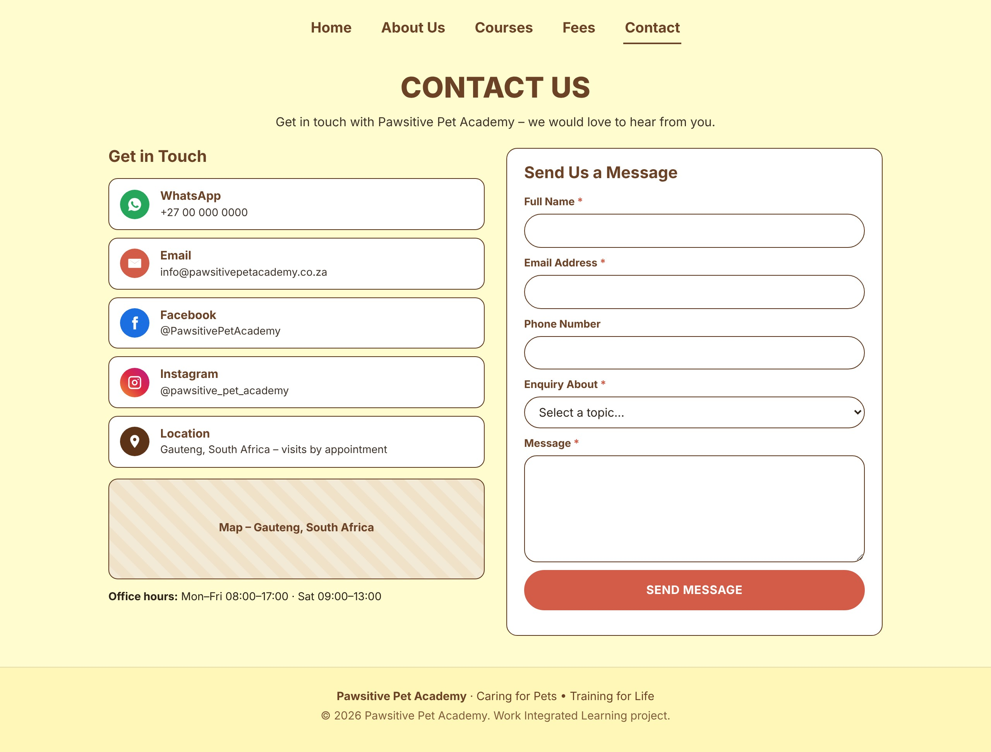

Contact Page
contact.html – Contact Us
Contact form
Name, email, topic and message are required
Email and phone formats are checked
Clear error messages appear under each field
A thank-you message confirms sending
Social media and details
WhatsApp, email, Facebook and Instagram links
Location and opening hours
Each link opens in one click
Notes:
Visitors can message the academy through the form or use the WhatsApp, email, Facebook and Instagram links. The form checks every field before it sends.

Slide 10

Website Design
Colour palette
Figma design
Built website
Cream
Brown
Dark
Coral
Beige
Typography: bold brown headings with clean sans-serif body text
Images: friendly dog photos from the Figma frames
Layout: centred navigation, rounded white cards and pill buttons
Same cards, wording, colours and button styles as the Figma Courses frame
Notes:
Left is the original Figma Courses frame, right is the finished website page. The palette, card layout, wording and buttons match.

Slide 11

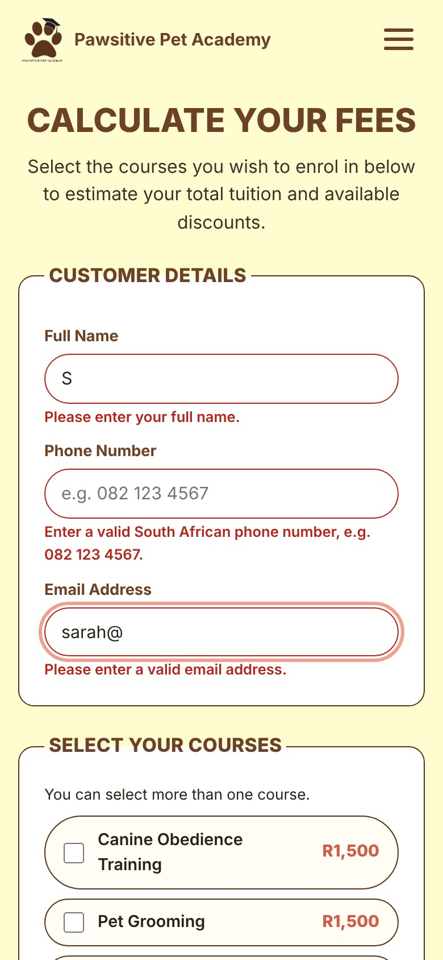



Website Functionality
Navigation
Fee calculator
Five links on every page, plus a menu button on phones
Totals update as courses are ticked, with discount and 15% VAT
Form validation
Responsive design
Required fields, email and phone checks, clear error messages
Layouts adapt from desktop to tablet and phone
Home on a phone
Validation on a phone
Notes:
Navigation, the calculator and validation all work in the browser with plain JavaScript. The two phone screenshots show the mobile layout and the validation messages.

Slide 12




Technologies Used
HTML5
CSS3
JavaScript
Visual Studio Code
Page structure and content across all 12 pages
Colours, Flexbox and Grid layouts, animations and responsive breakpoints
Fee calculator, form validation and the mobile menu
Code editor used to write and organise the project files
Plain code, no frameworks: the whole site is hand-written HTML, CSS and JavaScript.
Notes:
Only the four technologies required: HTML5, CSS3, JavaScript and Visual Studio Code. No frameworks were used.

Slide 13

Challenges and Solutions
Challenge
Matching the Figma designs
Solution
Sampled colours and spacing from the frames, then reused them through CSS variables and shared card styles.
Challenge
Incomplete content in some frames
Solution
Completed cut-off text and wrote matching outlines so all seven course pages are consistent.
Challenge
Calculating fees accurately
Solution
Wrote a JavaScript function for discount tiers and 15% VAT, then checked totals against hand calculations.
Challenge
Working on every screen size
Solution
Used CSS Grid, Flexbox and breakpoints with a mobile menu, then tested on desktop and phone widths.
Notes:
Four typical challenges and how each was solved: design matching, content gaps, accurate fee maths and responsive layout.

Slide 14

Conclusion
12
7
1
pages
courses
fee calculator
Benefits for the academy
Benefits for customers
Professional online presence
Courses and fees shown clearly
Easier enquiries and bookings
Easy to browse every course
Instant fee estimates
Simple ways to get in touch
Thank you – any questions?
Notes:
Summarise: a complete 12-page website that presents the academy, its seven courses, a working fee calculator and an easy contact route. Finish with thanks and questions.

